Slide 1

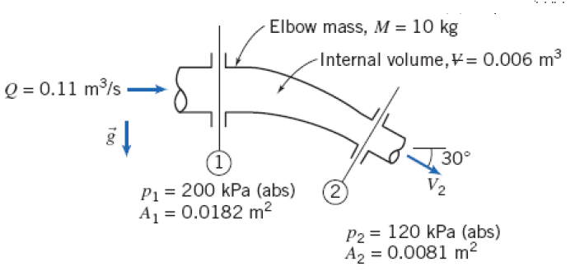
Problems

Slide 2


Slide 3





Slide 4




Slide 5

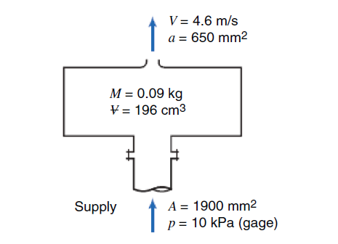

Slide 6




Slide 7
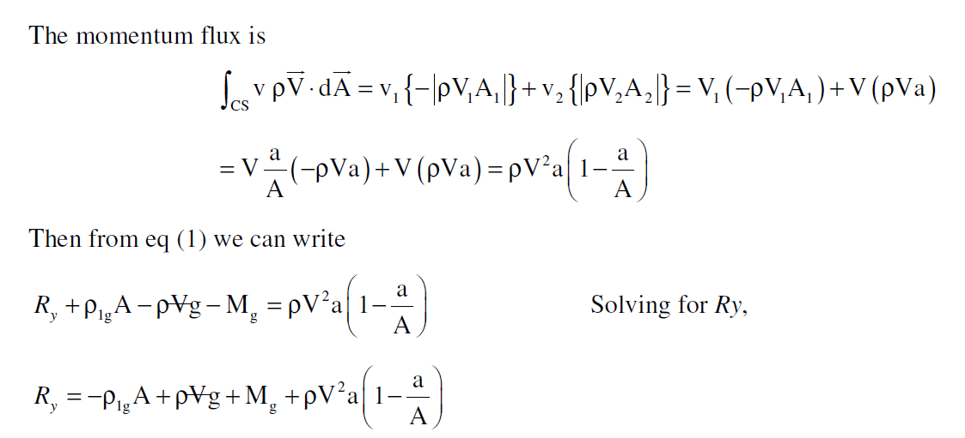


Slide 8


Slide 9

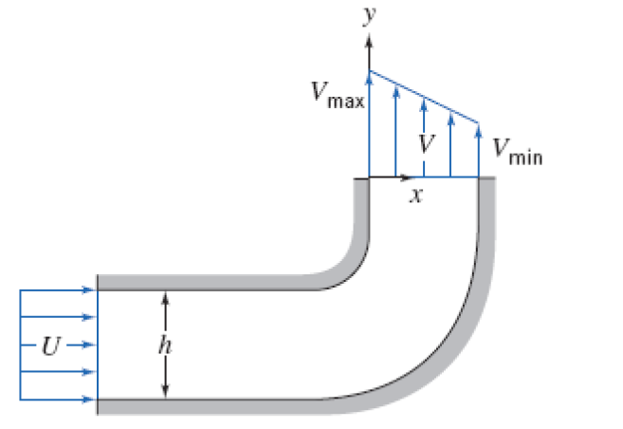

Slide 10
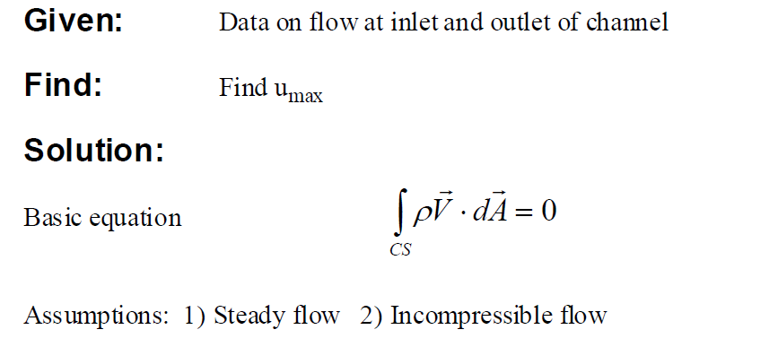

Slide 11


Slide 12
